Slide 1
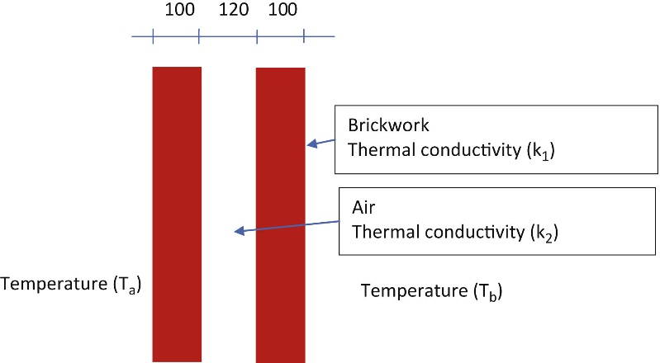
FIGURE 4.1 Cavity Wall

Slide 2
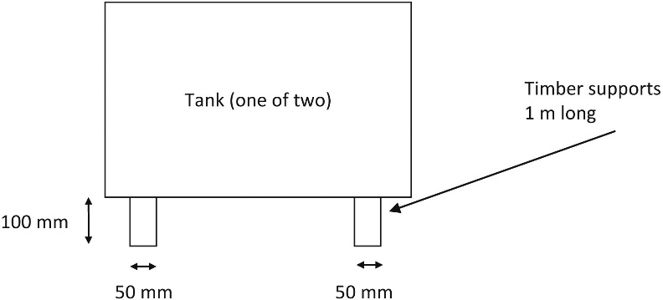

Slide 3
